Slide 1
Data Preprocessing ——Why pre-process data?——
徐华
清华大学 计算机系 智能技术与系统国家重点实验室
xuhua@tsinghua.edu.cn

Slide 2
Data Preprocessing
About data
Why preprocess the data?
Descriptive data summarization
Data cleaning
Data integration and transformation
Data reduction
Discretization and concept hierarchy generation
Summary

Slide 3
Why Data Preprocessing(1)
Data in the real world is dirty.
Incomplete(不完整): lacking attribute values, lacking certain attributes of interest, or containing only aggregate data
e.g., occupation=“”
Noisy（有噪音）: containing errors or outliers
e.g., Salary=“-10”
Inconsistent（不一致）: containing discrepancies（冲突） in codes or names:
External discrepancies
e.g., Age=“42” Birthday=“03/07/1997”
e.g., Was rating “1,2,3”, now rating “A, B, C”
e.g., discrepancy between duplicate records
Internal discrepancies
e.g., IngrA(10)+IngrB(3)+IngrC(4) -> Germ(70%)
IngrA(13)+IngrB(2)+IngrC(4) -> Germ(65%)

Slide 4
Why Data Preprocessing(2)
Incomplete data comes from
Different consideration between the time when the data was collected and when it is analyzed.
Human/hardware/software problems
Noisy data comes from the process of data
Collection
Entry
Transmission
Conflict with common sense
Inconsistent data comes from
Different data sources（Web，Manual Collections, Special Equipments, Database）
Actual Experiment Equipments (Sensors)
Different Environment Conditions (IOT Equipments)

Slide 5
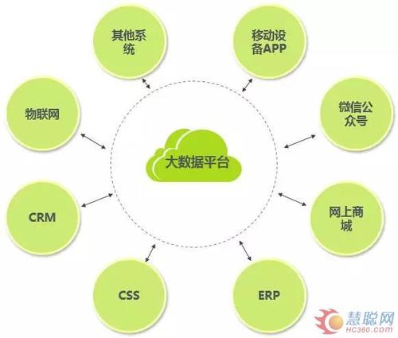
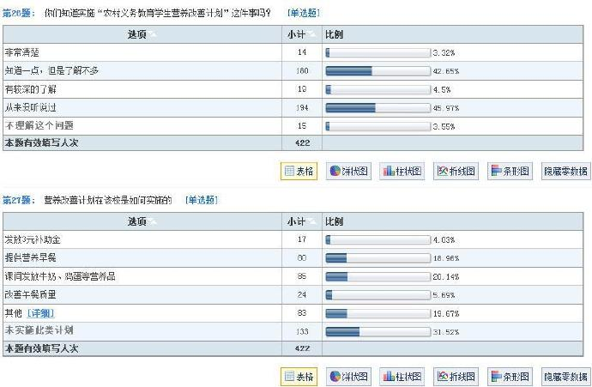
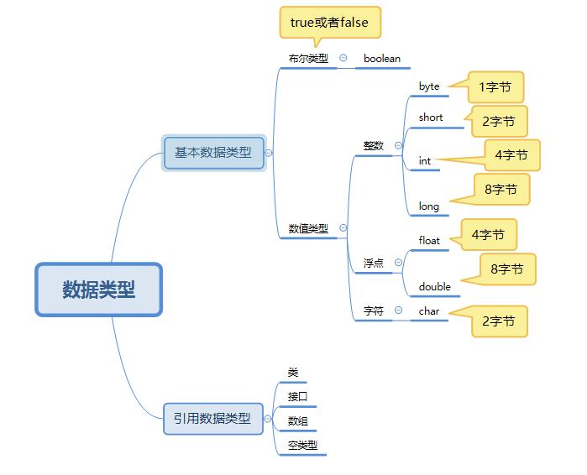
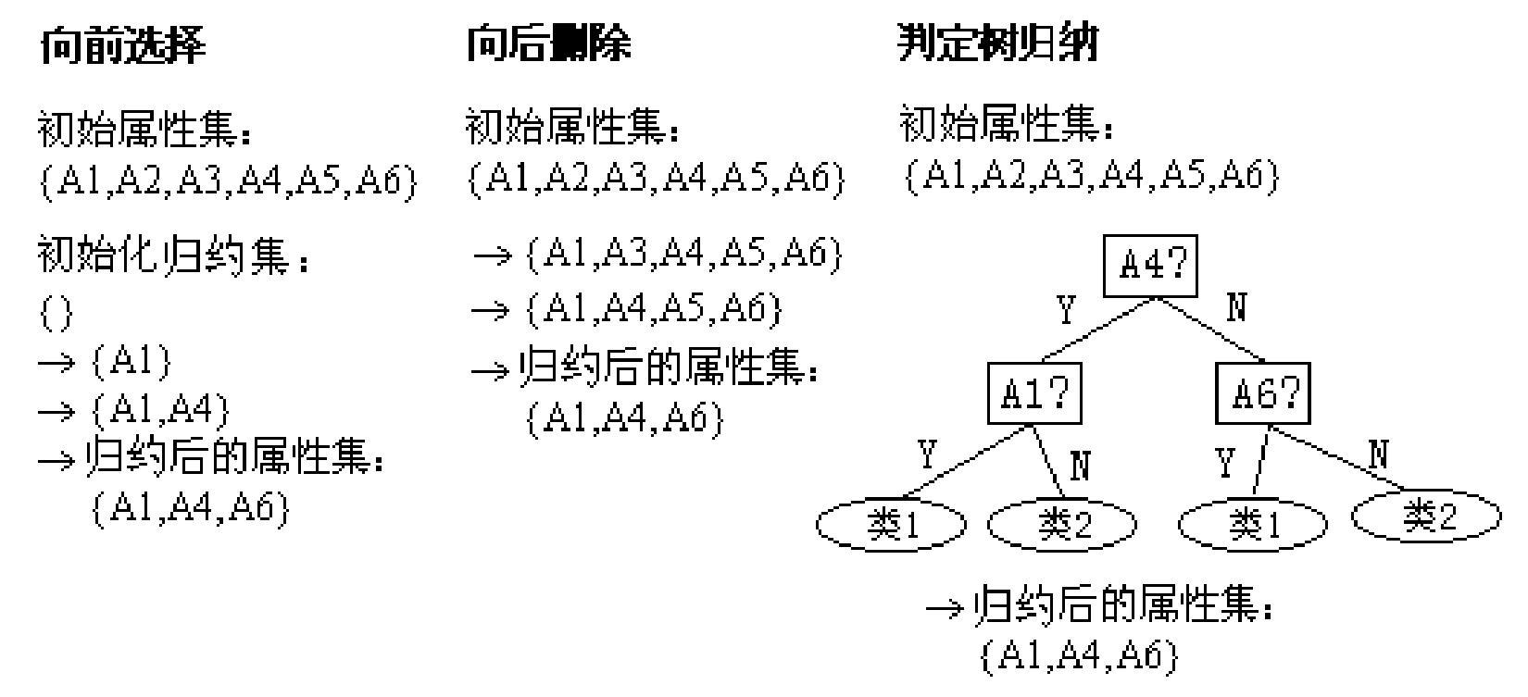
Why Data Preprocessing(3)
The form of data/information needs to be transformed.
Different data need to be integrated.
e.g. In Table A: Age =“”;
e.g. In Table B: Weight=“”
Different data need to be transformed.
e.g. questionnaire data
Different data need to be discretized.
Different data need to be reduced.

Slide 6
Why Is Data Preprocessing Important?
No quality data, no quality mining results!
Quality decisions must be based on quality data
e.g., duplicate or missing data may cause incorrect or even misleading statistics.
Data warehouse needs consistent integration of quality data
Data extraction, cleaning, and transformation comprises the majority of the work of building a data warehouse

Slide 7
Multi-Dimensional Measure of Data Quality
A well-accepted multidimensional view:
Accuracy（准确的）
Completeness（完整的）
Consistency（一致的）
Timelines（合时的）
Believability（可信的）
Value added（有附加价值的）
Interpretability（可解释的）
Accessibility（可存取的）
Broad categories:
Intrinsic(本质的), contextual（相关的）, representational（代表性的）, and accessibility（可存取的）.

Slide 8
Major Tasks in Data Preprocessing
Data cleaning
Fill in missing values, smooth noisy data, identify or remove outliers, and resolve inconsistencies
Data integration
Integration of multiple databases, data cubes, or files
Data transformation
Normalization and aggregation
Data reduction
Obtains reduced representation in volume but produces the same or similar analytical results
Data discretization
Part of data reduction but with particular importance, especially for numerical data

Slide 9
Form of data preprocess
Key Steps: Grasp and understand the data.

Slide 10
Thanks！
Notes:
工作新意图发现

